Slide 1
“Policy determines politics”
Lowi, Four Systems of Policy, Politics, and Choice, 1972

Slide 2
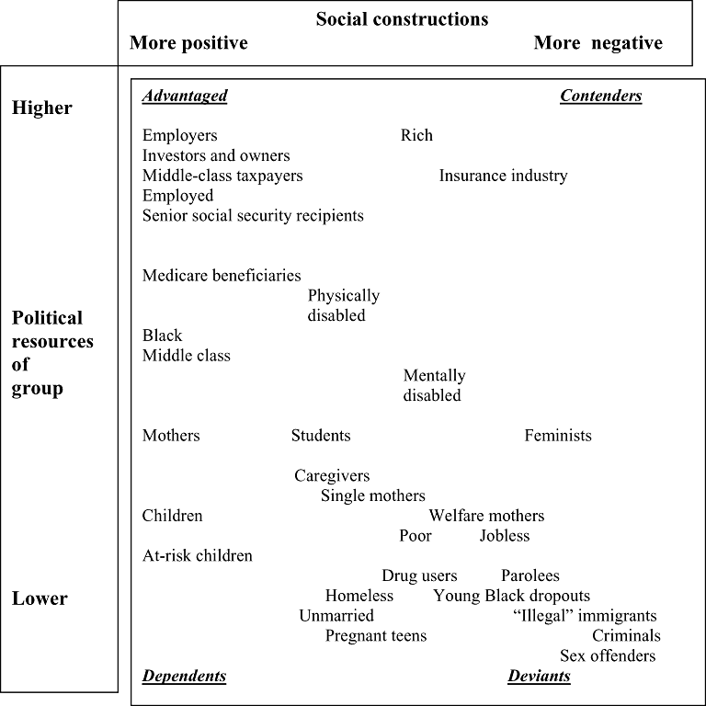
Schneider and Ingram’s Social construction of target populations (1993;1997)

Slide 3
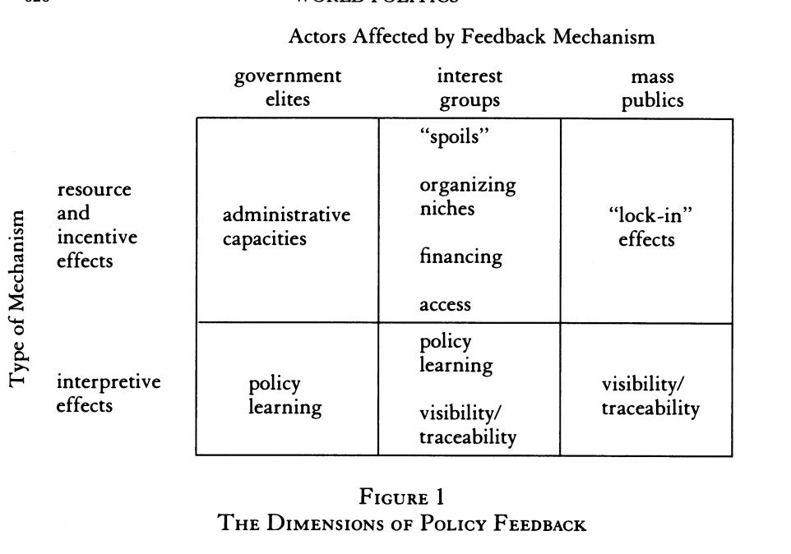
Pierson, Paul. "When Effect Becomes Cause: Policy Feedback and Political Change. » World Politics 45, no. 4 (1993): 595-628. doi:10.2307/2950710.

Slide 4


