Slide 1
Comparative Cultural Inequality and
Un/doing Differences
Stefan Hirschauer

Slide 2
1. Starting point: un/doing gender

Slide 3
1. Starting point: un/doing gender
class–ification: the distribution of persons over categories

Slide 4
1. Starting point: un/doing gender
class–ification: the distribution of persons over categories
undoing gender: limiting and interrupting gender coding

Slide 5
2. Extensions: doing cultural distinctions

Slide 6
2. Extensions: doing cultural distinctions
Mainz: comparitive studies in human categorization

Slide 7
2. Extensions: doing cultural distinctions
Mainz: comparitive studies in human categorization
Not ‚differences‘ and ‚kinds of people‘, but

Slide 8
2. Extensions: doing cultural distinctions
Mainz: comparitive studies in human categorization
Not ‚differences‘ and ‚kinds of people‘, but
a) processes of differentiation

Slide 9
2. Extensions: doing cultural distinctions
Mainz: comparitive studies in human categorization
Not ‚differences‘ and ‚kinds of people‘, but
a) processes of differentiation
b) multiple memberships in competition

Slide 10
3. Cultural in/equality

Slide 11
3. Cultural in/equality
Social inequality: mathematics (≠) + normativity

Slide 12
3. Cultural in/equality
Social inequality: mathematics (≠) + normativity
Cultural in(e)quality: each categorisation creates equals and unequals

Slide 13
3. Cultural in/equality
Social inequality: mathematics (≠) + normativity
Cultural in(e)quality: each categorisation creates equals and unequals
unequal: a heterosocial relation

Slide 14
4. Human differentiation: Building Differences and Asymmetries

Slide 15
4. Human differentiation: Building Differences and Asymmetries
Human kinds as cultural species

Slide 16
4. Human differentiation: Building Differences and Asymmetries
Human kinds as cultural species
Four points of contact:

Slide 17
4. Human differentiation: Building Differences and Asymmetries
Human kinds as cultural species
Four points of contact:
bodily invariants

Slide 18
4. Human differentiation: Building Differences and Asymmetries
Human kinds as cultural species
Four points of contact:
bodily invariants biographical anchors

Slide 19
4. Human differentiation: Building Differences and Asymmetries
Human kinds as cultural species
Four points of contact:
bodily invariants biographical anchors
biographical trajectories

Slide 20
4. Human differentiation: Building Differences and Asymmetries
Human kinds as cultural species
Four points of contact:
bodily invariants biographical anchors
biographical trajectories situative achievements

Slide 21
4. Human differentiation: Building Differences and Asymmetries
Human differentiation

Slide 22
4. Human differentiation: Building Differences and Asymmetries
Human differentiation
distinction

Slide 23
4. Human differentiation: Building Differences and Asymmetries
Human differentiation
distinction
categorisation

Slide 24
4. Human differentiation: Building Differences and Asymmetries
Human differentiation
distinction
categorisation
classification

Slide 25
4. Human differentiation: Building Differences and Asymmetries
Specifics of human categorisation:

Slide 26
4. Human differentiation: Building Differences and Asymmetries
Specifics of human categorisation:
1. humans participate in their categorisation

Slide 27
4. Human differentiation: Building Differences and Asymmetries
Specifics of human categorisation:
1. humans participate in their categorisation
2. latent asymmetry by self-positioning in distinguishing

Slide 28
4. Human differentiation: Building Differences and Asymmetries
Specifics of human categorisation:
1. humans participate in their categorisation
2. latent asymmetry by self-positioning in distinguishing
a) differentiated own – totalised other

Slide 29
4. Human differentiation: Building Differences and Asymmetries
Specifics of human categorisation:
1. humans participate in their categorisation
2. latent asymmetry by self-positioning in distinguishing
a) differentiated own – totalised other
b) normality of the own – marked deviance of the other

Slide 30
4. Human differentiation: Building Differences and Asymmetries
Human differentiation
distinction
categorisation
classification
alterisation

Slide 31
4. Human differentiation: Building Differences and Asymmetries
Human differentiation
distinction
categorisation
classification
alterisation
asymmetric distinctions

Slide 32
4. Human differentiation: Building Differences and Asymmetries
asymmetric distinctions:
la distinction,

Slide 33
4. Human differentiation: Building Differences and Asymmetries
asymmetric distinctions:
la distinction, devaluation,

Slide 34
4. Human differentiation: Building Differences and Asymmetries
asymmetric distinctions:
la distinction, devaluation, discrimination,

Slide 35
4. Human differentiation: Building Differences and Asymmetries
asymmetric distinctions:
la distinction, devaluation, discrimination, stigmatisation

Slide 36
4. Human differentiation: Building Differences and Asymmetries
Human differentiation
distinction
categorisation
classification
alterisation
asymmetric distinctions
social boundaries

Slide 37
4. Human differentiation: Building Differences and Asymmetries
Human differentiation
distinction
categorisation
classification
alterisation
asymmetric distinctions
social boundaries
polarisation

Slide 38
5. Conclusion: Inclusion needs in–difference

Slide 39
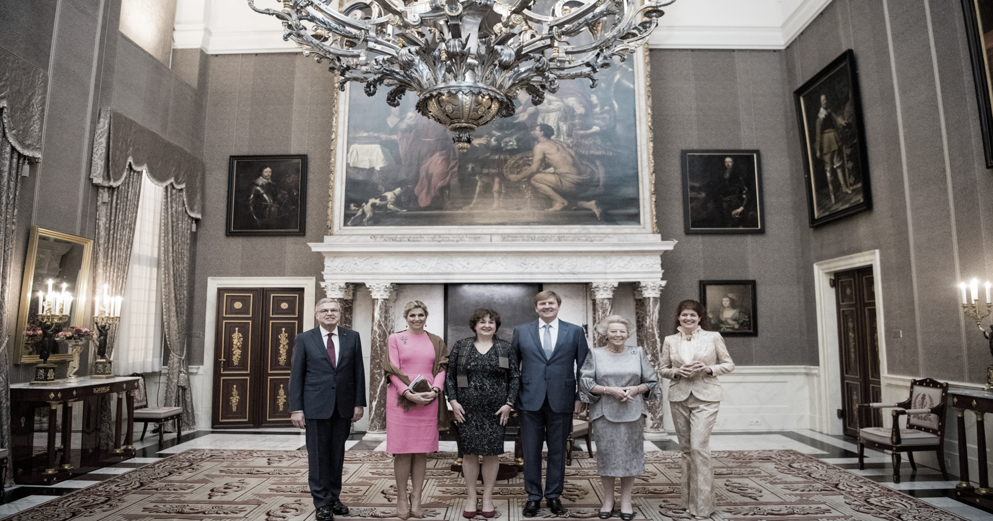

Slide 40
5. Conclusion: Inclusion needs in–difference
‚diversity‘ essentializes differentiation

Slide 41
5. Conclusion: Inclusion needs in–difference
‚diversity‘ essentializes differentiation
‚identity‘ reifies self-understandings

Slide 42
5. Conclusion: Inclusion needs in–difference
‚diversity‘ essentializes differentiation
‚identity‘ reifies self-understandings
the opposite of stigmatisation isn‘t recognition, but in–difference

Slide 43
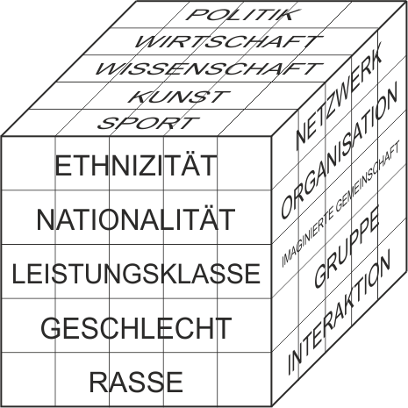
Funktionale
Differenzierung der
Gesellschaft
Soziale Differenzierung
von Gesellungsformen
Formen der
Humandifferenzierung

Slide 44
z
de-differentiation of x
inhibiting x
x-ation
x-ing
undoing x
doing x
undoing being x
doing being x
doing x while doing y
x-ing effecting y-ing
y

